Slide 1
Simple As Possible
Computer

Slide 2
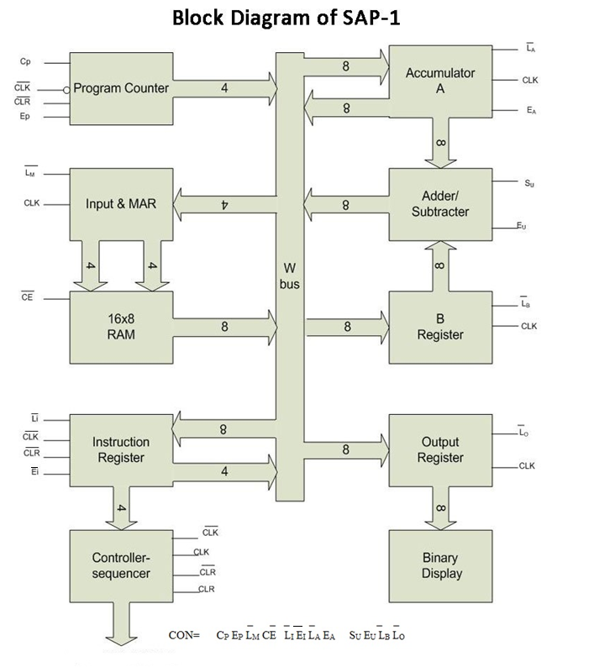
Block Diagram

Slide 3
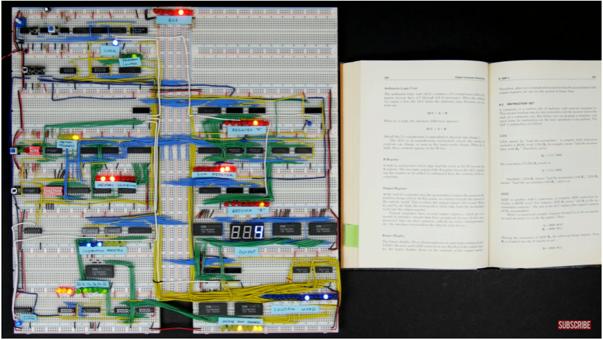
Ben Eater 8 bit Computer
https://youtu.be/HyznrdDSSGM

Slide 4
4-bit address, 8-bit data
8 bit W bus
4 bit program counter
4 bit memory address register (MAR)
16 byte memory (16*8)
8 bit Instruction Register
8 bit Accumulator
8 bit B Register
8 bit Adder
8 bit Output Register

Slide 5
Instruction Set
LDA <memory address>
accumulator=content of memory address
ADD <memory address>
accumulator<=acc. + content of mem.
SUB <memory address>
accumulator<=acc. - content of mem.
1,2,3: Memory Reference Instruction

Slide 6
Instruction Set
4. OUT
out register = accumator
5. HLT
-stops clock

Slide 7
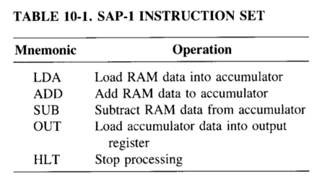
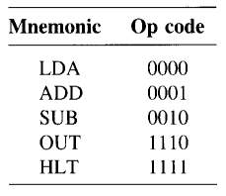
Instruction Set

Slide 8
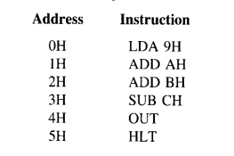
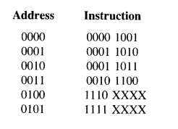
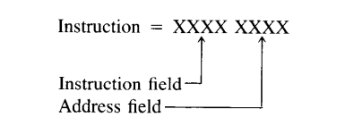
Instruction Set

Slide 9
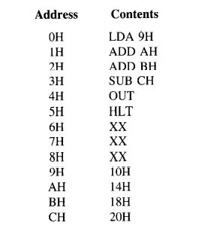
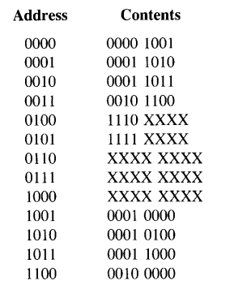

Instruction Set

Slide 10
Example
25-9+10-18=?
-Load 25 in accumulator
-Subtract 9 from 25
-Add 10 with the result
-Subtract 18
-Show output

Slide 11
Example
25-9+10-18=?
Source Code | Machine Code
LDA CH | 00001100
SUB DH | 00101101
ADD EH | 00011110
SUB FH | 00101111
OUT | 1110XXXX
HLT | 1111XXXX
F | 00010010 | 7 | XXXXXXXX
E | 00001010 | 6 | XXXXXXXX
D | 00001001 | 5 | 1111XXXX
C | 00011001 | 4 | 1110XXXX
B | XXXXXXXX | 3 | 00101111
A | XXXXXXXX | 2 | 00011110
9 | XXXXXXXX | 1 | 00101101
8 | XXXXXXXX | 0 | 00001100

Slide 12

Control Word
CON=
= 0 0 1 1 1 1 1 0 0 0 1 1
= 3 E 3 H
ALL INACTIVE

Slide 13
Timing (T) States
Controller/Sequencer controls all the operations. Each instruction is executed through a series of step. Each such step is called a Timing state (T state)
The 6 bit Ring Counter produces 6 T states for SAP-1
Different CON words are produced in different T states

Slide 14
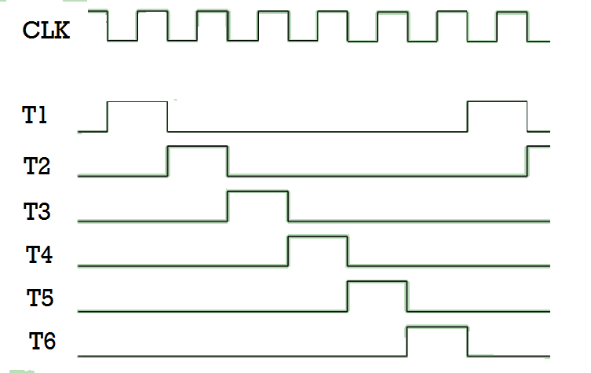
T states

Slide 15
Implementing an Instruction
+
Execution
Fetch
Implementing LDA 9H

Slide 16
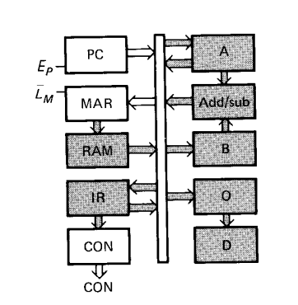
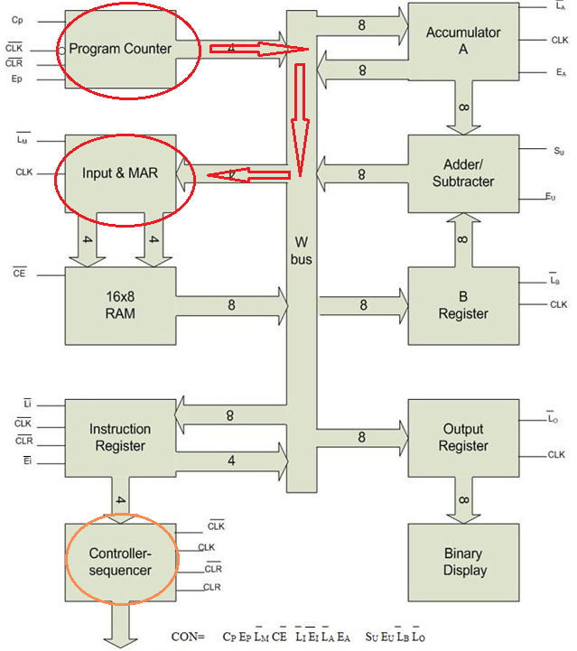
Fetch Cycle : T1
CON = ?
= ?
T1: Address State

Slide 17
Fetch Cycle : T1
CON= 0101 1110 0011
= 5 E 3 H
T1: Address State

Slide 18
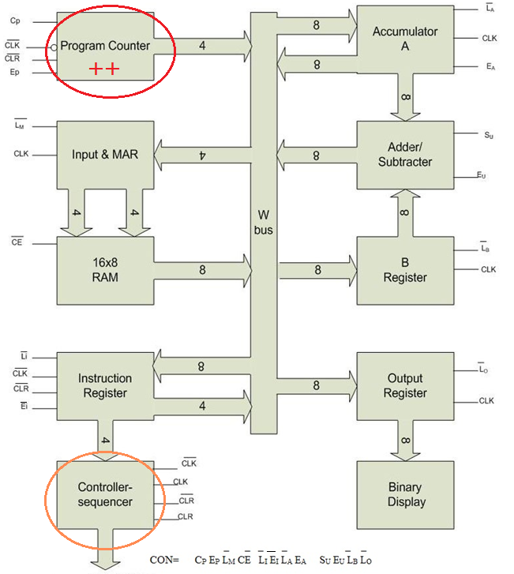
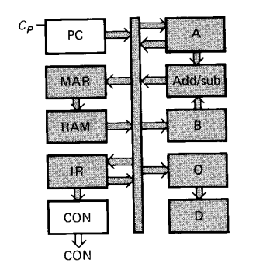
Fetch Cycle : T2
CON = ?
= ?
T2: Increment State

Slide 19
Fetch Cycle : T2
CON= 1011 1110 0011
= B E 3 H
T2: Increment State

Slide 20
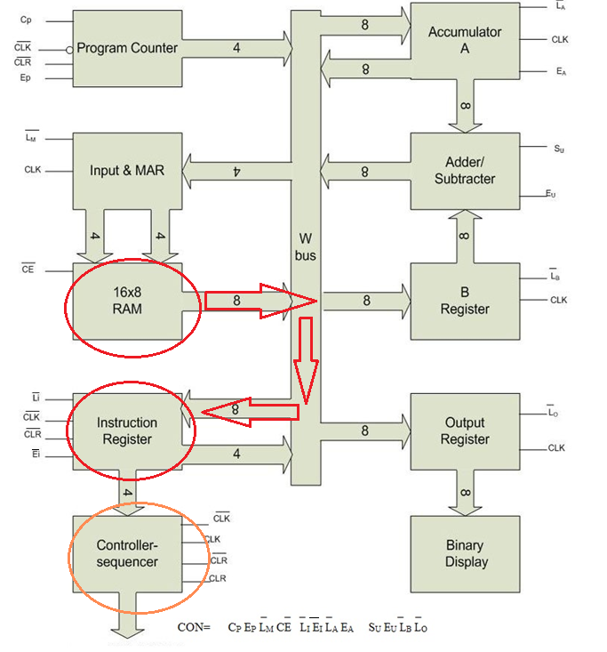
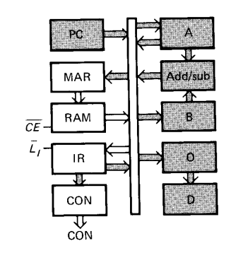
Fetch Cycle : T3
CON = ?
= ?
T3: Memory State

Slide 21
Fetch Cycle : T3
CON= 0010 0110 0011
= 26 3 H
T3: Memory State

Slide 22
Fetch Cycle
Execution Cycle
T1: Address State
T2: Increment State
T3: Memory State
T4
T5
T6
Similar for all kinds of Instructions.
ADD, SUB, LOAD
Depend on the particular instruction being executed.
LDA 9H requires different register transfers than ADD BH.

Slide 23
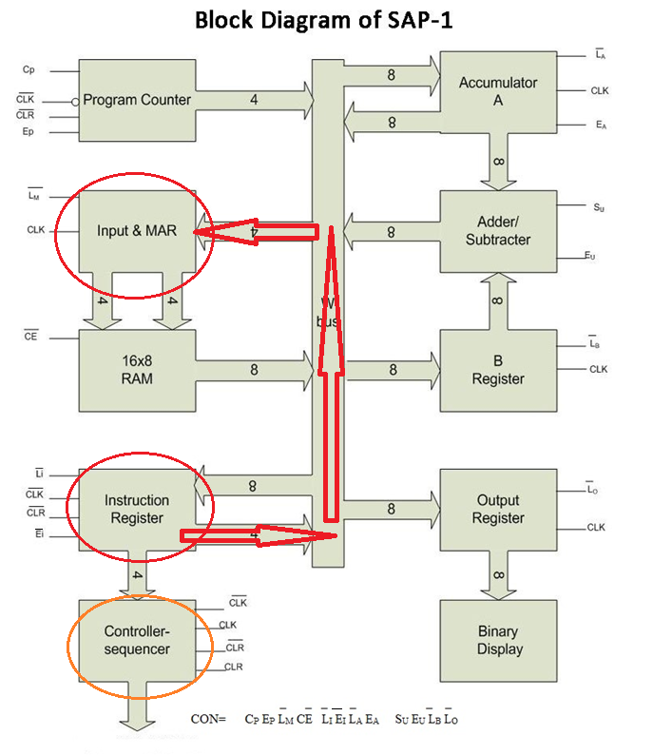
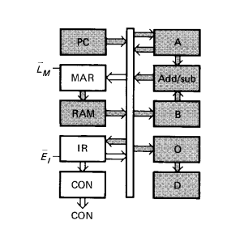
Execution Cycle : T4 <LDA>
CON= 0001 1010 0011
= 1A3 H

Slide 24
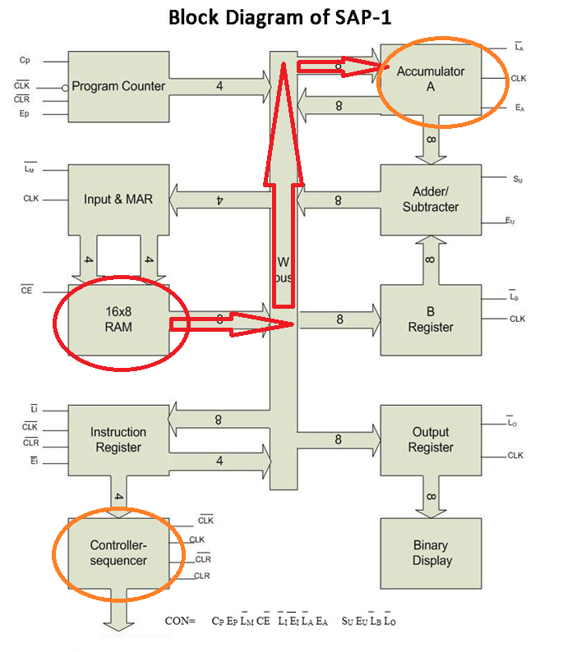
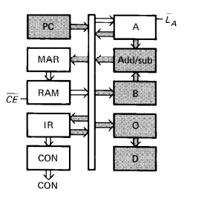
Execution Cycle : T5 <LDA>
CON= 0010 1100 0011
= 2C3 H

Slide 25
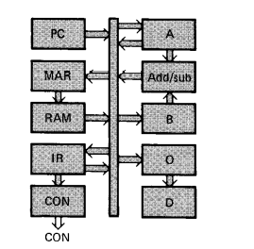
Execution Cycle : T6 <LDA>
CON= 0011 1110 0011
= 3E3 H
NOP

Slide 26
